Slide 1
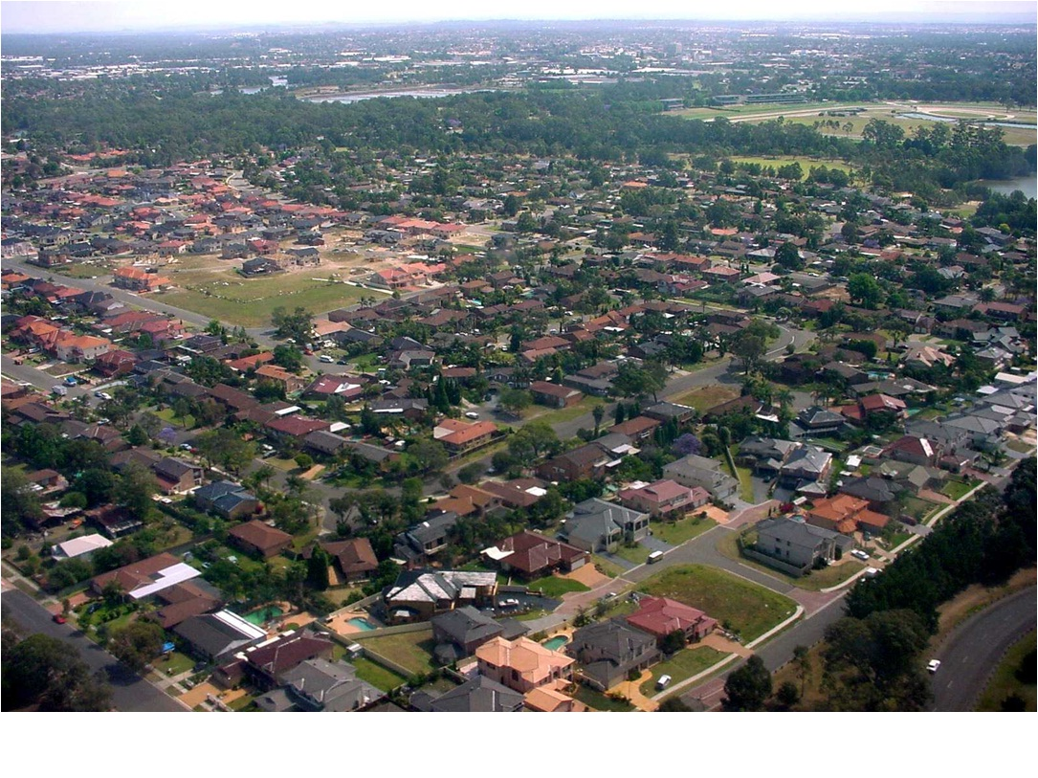
Building Models with the Application of New Ideas
Notes:
There is a lot of data. Data comes in different shapes and sizes. Outliers
http://www.birdsinbackyards.net/sites/www.birdsinbackyards.net/files/aerial%20view%20of%20a%20suburb_2.jpg - picture

Slide 2
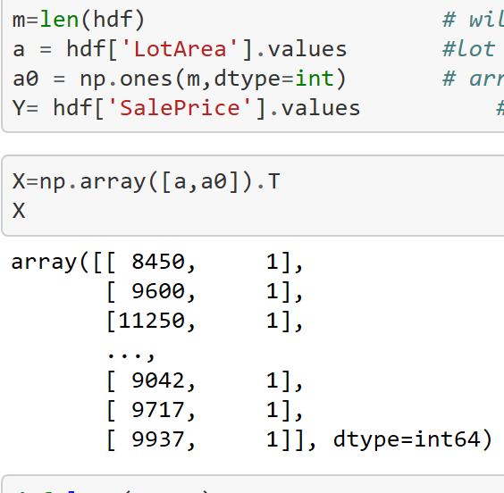
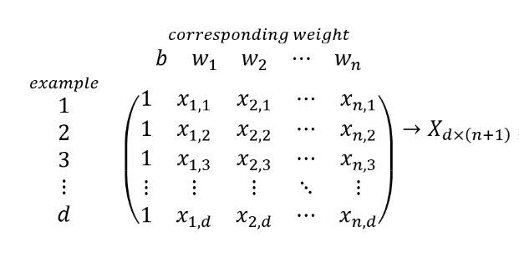
Data Transformation
Notes:
We are preparing an array to use formula

Slide 3
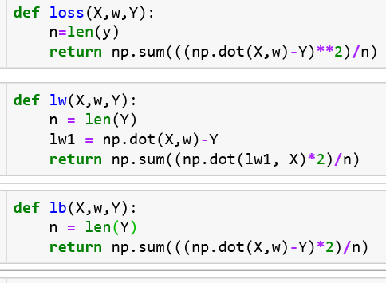
3 functions
Loss
Derivative
Bias

Slide 4
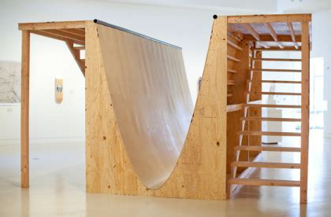
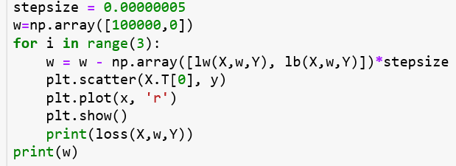
Gradient Descent

Slide 5
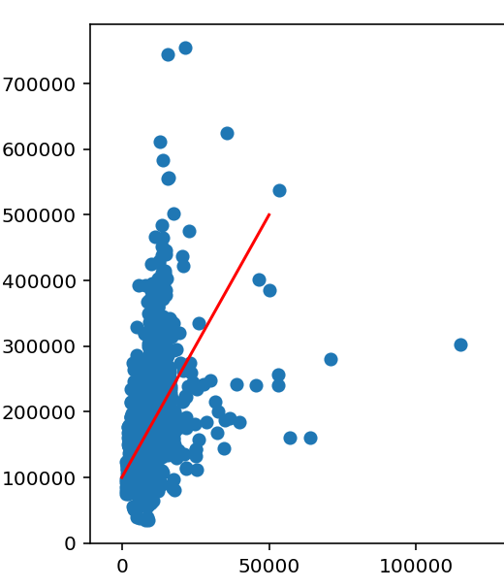

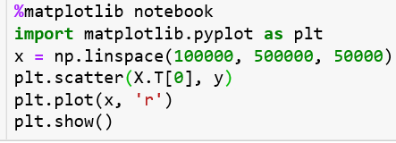
Model Line
Notes:
What’s the point?

Slide 6
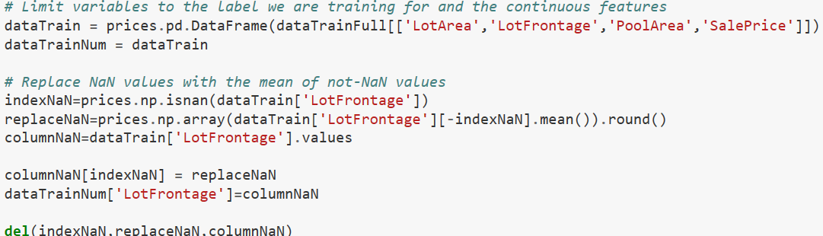
Further Steps

Slide 7
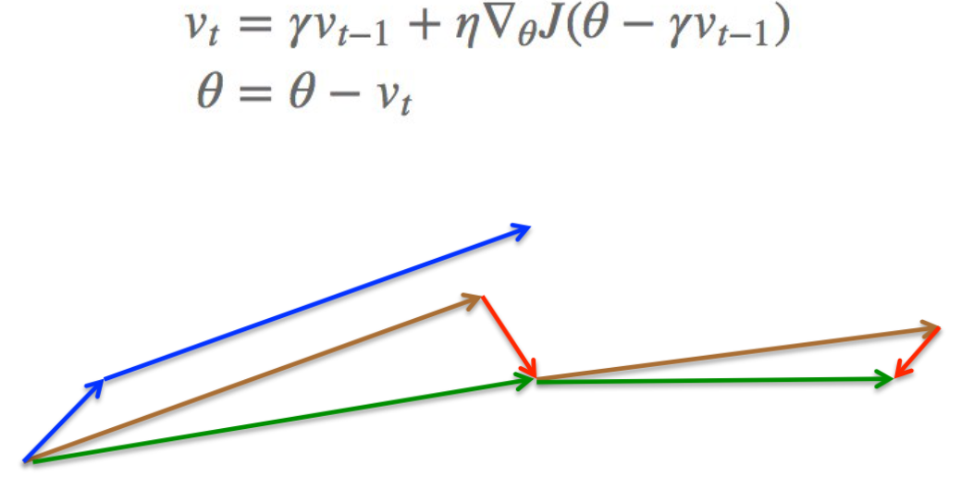
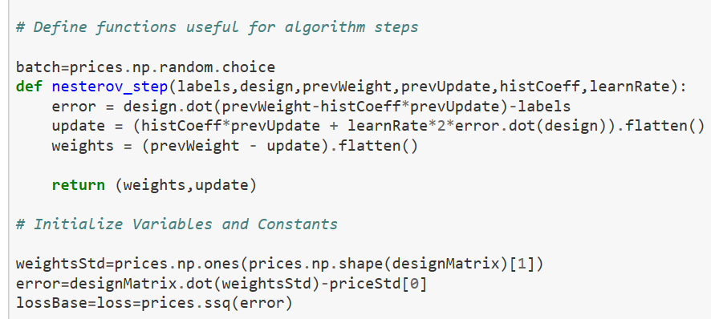
Nesterov (Accelerated Learning Rate)
Notes:
Comparing this to the former method, the complexity really stands out. There are simple and complex ways to perform different functions

Slide 8
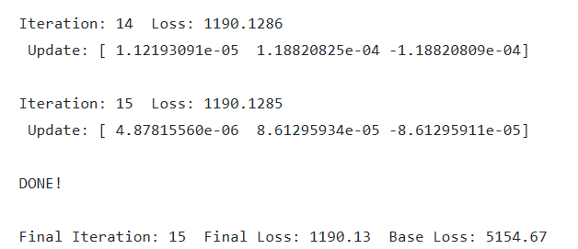
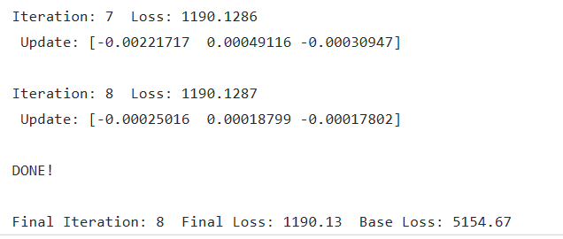
What are the Benefits?
Normal Approach
Nesterov

Slide 9
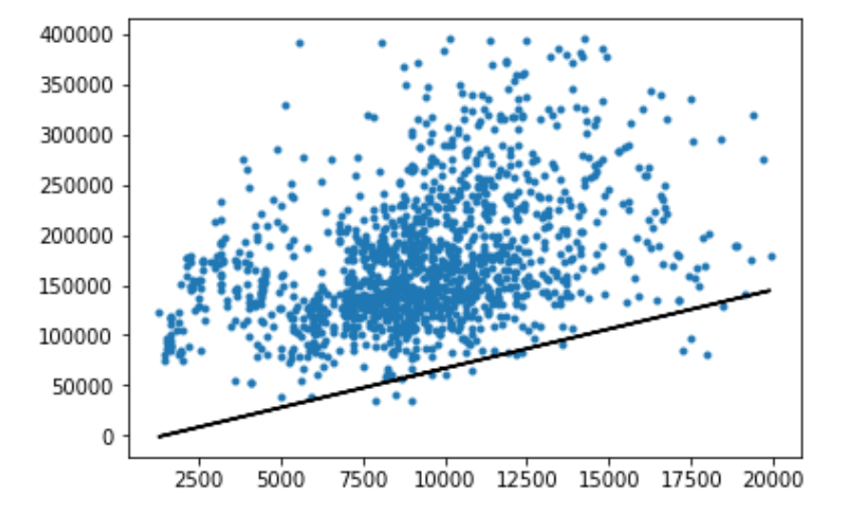
Using a more complex Variation

